Slide 1
2013-03-15 CERN Machine Advisory Committee
Slides for Rhodri's CMAC presentation
Planned & Possible Upgrades related to:
LHC Long-Range Beam-Beam Compensator &
LHC Head-Tail Diagnostics
Ralph J. Steinhagen,
Beam Instrumentation Group, CERN;

Slide 2
Motivation/Context
2012 LHC operation indicated potential luminosity-performance limitations:
  Max. bunch charge nb > 1.7·1011 ppb (50 ns operation) → intra-bunch instabilities during RAMP & ADJUST (IP8 bunches)
  Max. beam intensity (25 ns operation) → e-cloud & bunch-by-bunch instabilities
  Min. crossing angle (limits min β*) → long-range beam-beam for <~9σ separation
After LS1, LHC will operate at increased beam intensities and energy for which these effects are expected to become more important → need better diagnostics to understand, improve and mitigate these effects if we want to maintain/improve the present luminosity performance, e.g. among others:
  Long-range beam-beam compensator (BBC) → Prototype installation in IR1 & 5 during or shortly after LS1
  Inter- and intra-bunch beam diagnostics
    Multiband-Instability-Monitor (MIM)
      Detect and identify instabilities during the onset
      Quantify effective beam stability margin under safe conditions
    Wide-band acquisition with ultra-large buffer (>10k turns@20 GS/s)
      idea similar to aviation industry's 'flight-recorder'
  New ultra-wide-band pick-up designs (>12 GHz)
    Electro-optical and synchrotron-light based BPM (initial prototype at SPS)
Add. developments on the RT-FBs and continous beta* squeeze affecting BI
  Lumi-levelling, RF commutation switches for BPMSWs, + some smaller items

Slide 3
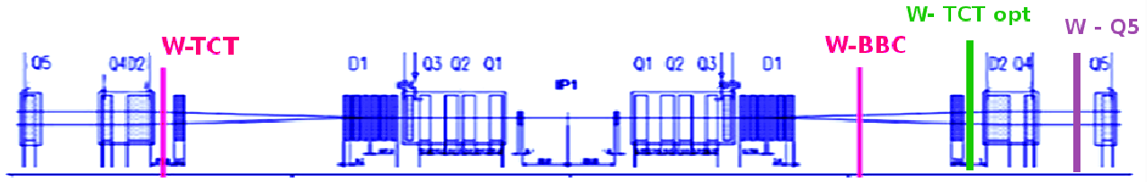
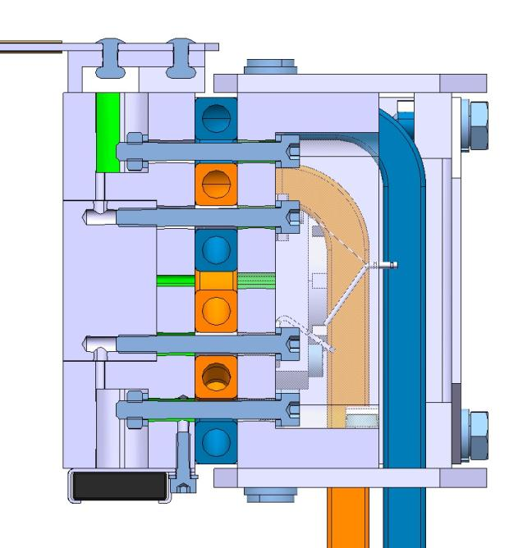
Long-Range Beam-Beam Compensator Prototype I/II
Target prototype installation in IR1 & 5 during or shortly after LS1 (B1 only)
  BBC.B1-H replacing TCL.xR1.B1 & BBC.B1-V replacing TCT(P).xL5.B1
Acceptable compromise between function, MP, engineering & schedule
Wire-in-Jaw Design replacing TCTP/TCL...
  minimises the MP risk w.r.t. asynchronous dumps,
  reuses collimation infrastructure, and
  allows testing with nom. (/ATS) optics
March'13 integration & cooling proof-of-concept
BBC-TCTP integration to start soon → aim to be ready by the end or shortly after LS-1
BBC wire
9.5-11σ
clearance
beam
y
x
TCTP-BBC jaw assembly

Slide 4
Long-Range Beam-Beam Compensator Prototype II/II
What can be demonstrated after LS-1
Analysis: T.Rijoff & F. Zimmermann

Slide 5
Long-Range Beam-Beam Compensator Prototype II/II
ALTERNATE: What can be demonstrated after LS-1
Analysis: T.Rijoff & F. Zimmermann

Slide 6
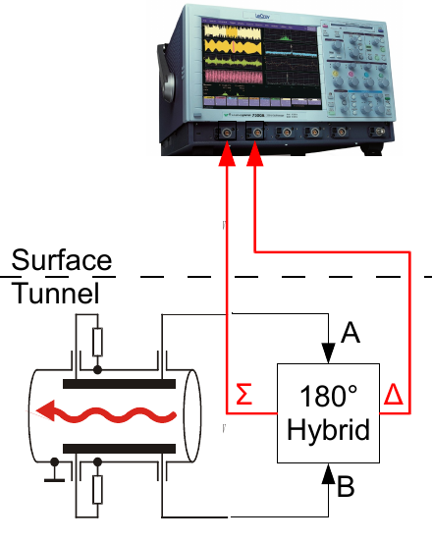
Inter- and Intra-bunch Beam Diagnostics
Classic Head-Tail Detection Scheme
Major paradigm change from 'Q' H-T diagnostics' to an 'inter- and intra-bunch instability monitor'!
Present main limitations:
Sampling limited to 8/~6.3 ENOB ↔ resolution ~100 um
  Beam typ. lost before visible with HT
  Q/Q' diag. requires ~2 σ kick amplitudes → emittance blow-up (similar to BPM/ADT)
Sampling buffer: original HT tracks single bunch over 1-2k turns vs. all bunches < 10 turns
  issues: oscilloscope reliability,read-out perf., IT safety, integration, …
Shorter bunches, higher modes → need increased system bandwidth
Issue of instabilities of interest occurring …
  … on any & a priori unknown bunch,
  … at a not precisely/unknown time during the fill
→ Upgrade proposal: implement something similar to what is known in aviation industries as a 'flight recorder'

Slide 7
Upgrade/Improvement Road-Map
Tackle three domains independently:
Pick-up – improve bandwidth, linearity, power-issues, EMC susceptibility:
  Synchrotron-Light based BPM → dual use CTF3 & LHC
    Collaboration with ACAS (Uni-Melbourne and ASLS)
  Direct EO-based BPM → machine/beam type independent
    Plan to design/integrate prototype monitor to be installed in SPS during LS-1
  Wider-band, electro-magnetic pick-up → ???
Analog front-end:
  Time-Domain: new wide-band ~DC-6/8 GHz Σ-Δ hybrid
  Frequency-Domain: new Multiband-Instability-Monitor (MIM)
    Used also as a pre-/post-trigger for the time-domain acquisition
    Collaboration with ACAS (Uni-Melbourne and ASLS)
Digital-Data-Acquisition – large PM-type history buffer, online pre-processing
  GUZIK DAQ: 64GB, 20 GS/s, 4.5 – 13 GHz BW, ext. FPGA firmware
  Bunch-by-bunch DAQ (needed for B.2) ↔ related to b-b-b BBQ activities

Slide 9
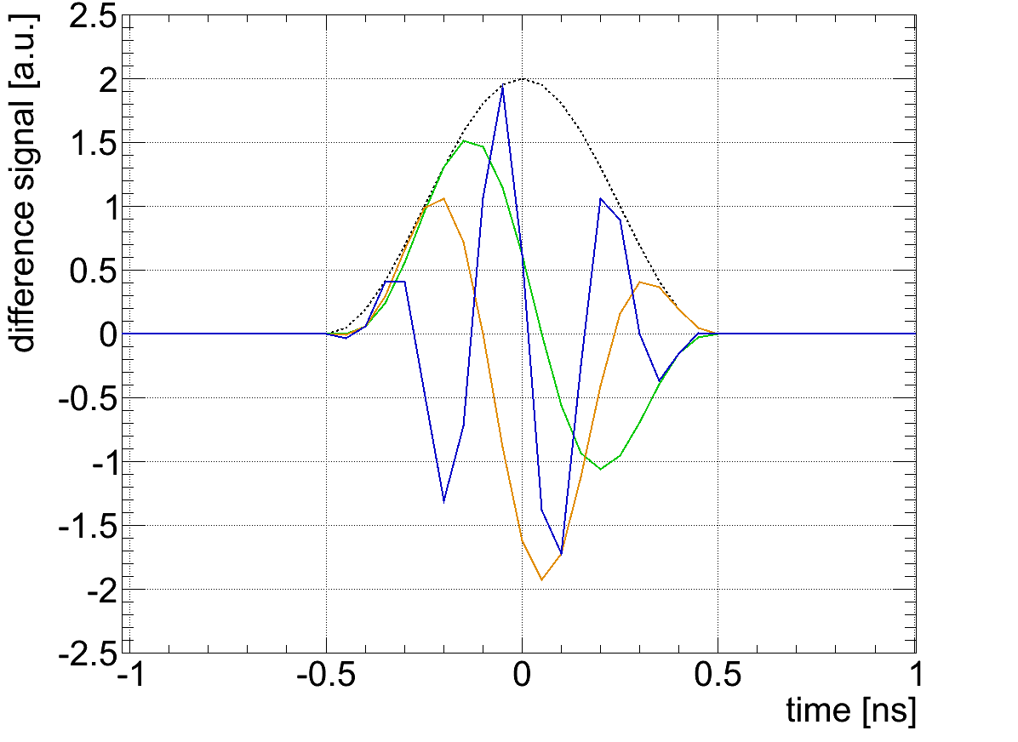
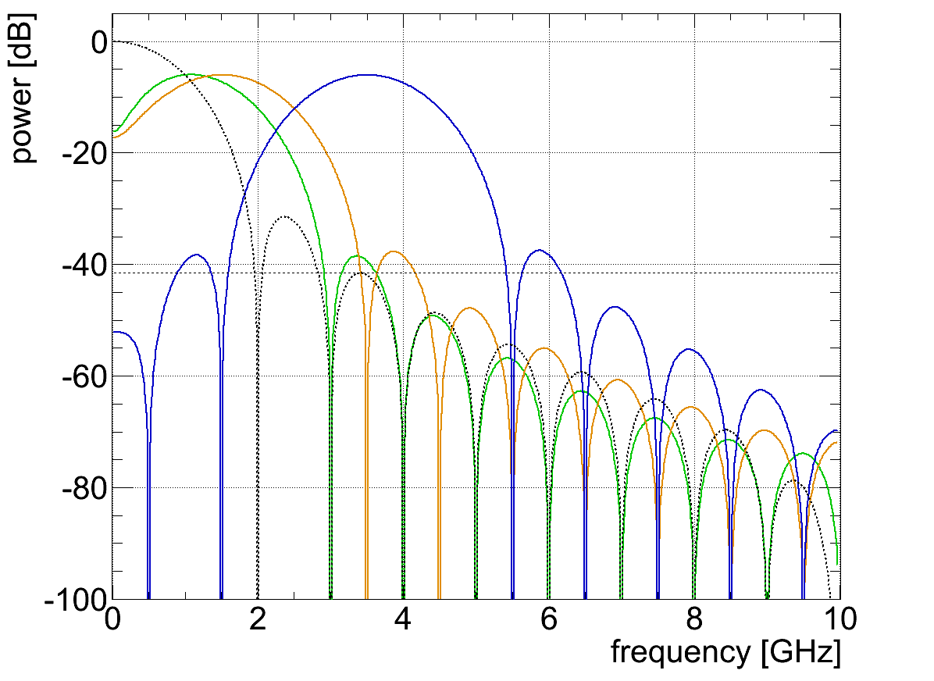
Analog Front-End – Frequency Domain I/V
Multiband-Instability-Monitor (MIM)
Time-domain analysis in the few GHz range will remain limited to ~100 um resolutions for a couple of years to come …
  N.B. beams typically (being) lost before having measured any significant oscillation
Take a different angle to by-pass this problem: exploit and analyse signal in frequency domain where much larger dynamic ranges are possible
channel index
0 1 2 3 4 5 6 7 8 9
...
m=1
m=2
m=5
sum or
'm=0' signal
m=1
m=2
m=5

Slide 10
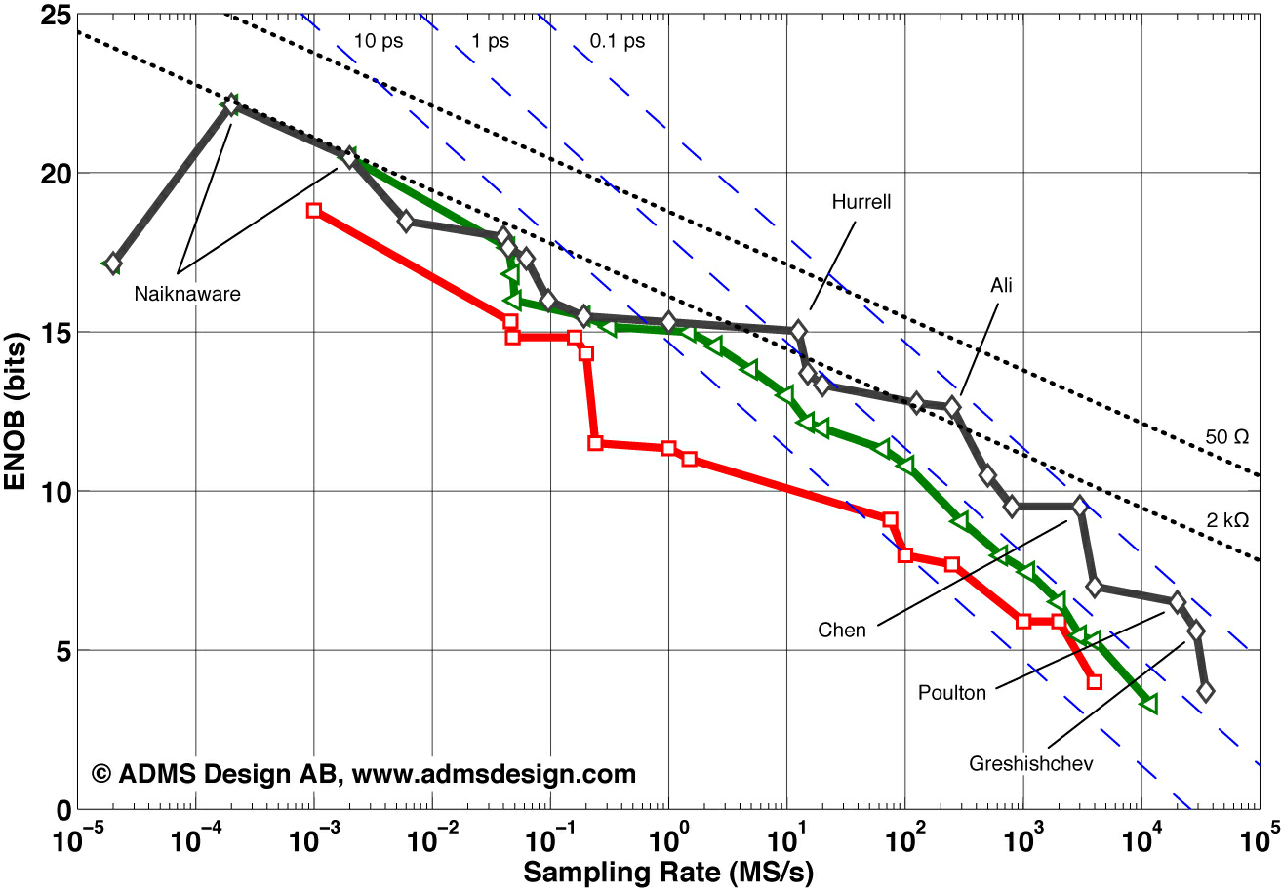
Analog Front-End – Frequency Domain II/V
Multiband-Instability-Monitor (MIM) – Resolution
Pushes the envelope of what can be done with modern ADCs
BBQ
MIM
ADS542LB69
1990
2000
present
Time-domain direct digitisation/oscilloscopes

Slide 11
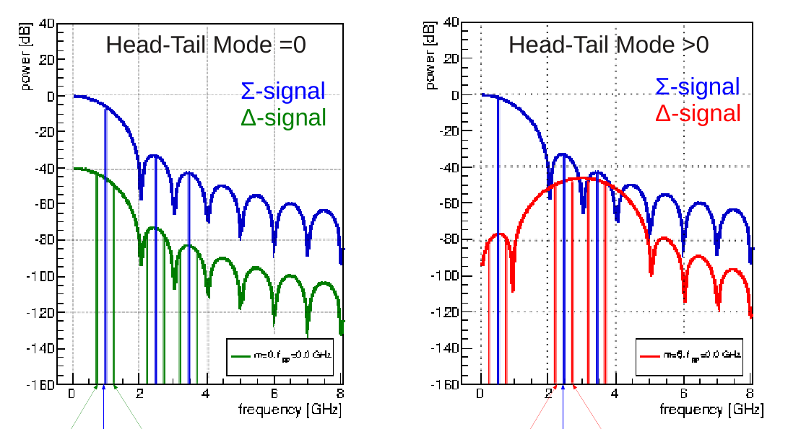
Analog Front-End – Frequency Domain III/V
Multiband-Instability-Monitor (MIM)
Example: if the there is more power in 'CH n≥1' → head-tail instability
A full diagnostics chain in its own right but will also be used to pre-trigger the time-domain based data acquisition
frev-fq
frev
frev+fq
frev-fq
frev
frev+fq

Slide 12
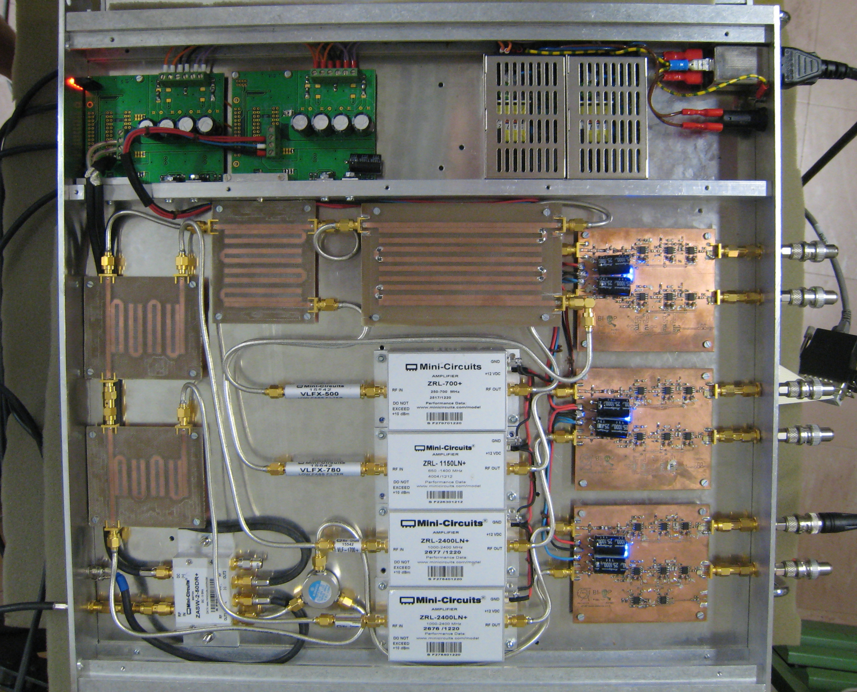
Analog Front-End – Frequency Domain IV/V
Multiband-Instability-Monitor (MIM)
full-range
0.4 GHz
0.8 GHz
1.2 GHz
1.6 GHz
full-range
Δ-Signal
Proof-of-concept successfully tested in SPS & LHC, next steps:
  Integrate 16 (/32) channels/unit and bunch-by-bunch (tbc. during upcoming review) data acquisition and post-processing
  Improves the diagnostics for safe testing of beam stability margin: re-use existing BQK as wide-band kicker to excite specific head-tail and TMCI modes for measuring the growth/damping time of a given mode (N.B. Low ~300-400 W power requirement)

Slide 13
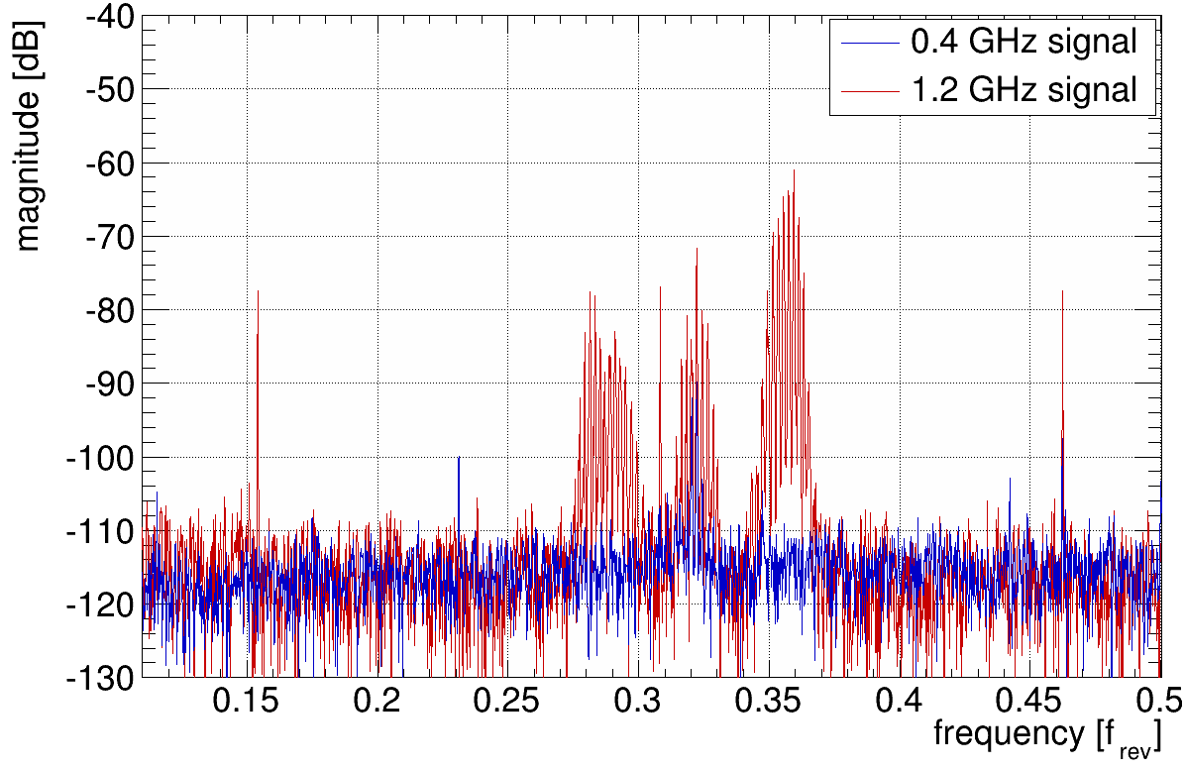
Analog Front-End – Frequency Domain V/V
Multiband-Instability-Monitor (MIM)
B1-V instability during ADJUST as measured by the MIM prototype:
Little activity in the 400 MHz band compared to the 1.2 GHz band (vivid Qs sidebands) indicates that this instability is related to an intra-bunch motion (simulation/additional measurements are indicative of a TMCI)
More sensitive than direct time-domain detection (i.e. using oscilloscopes)
Can be used to safely measure beam stability margin using growth/damping time measurements while varying machine parameters within the same fill (i.e. varying Q', octupoles, beam-beam separation, etc.)
2012-12-04

Slide 14
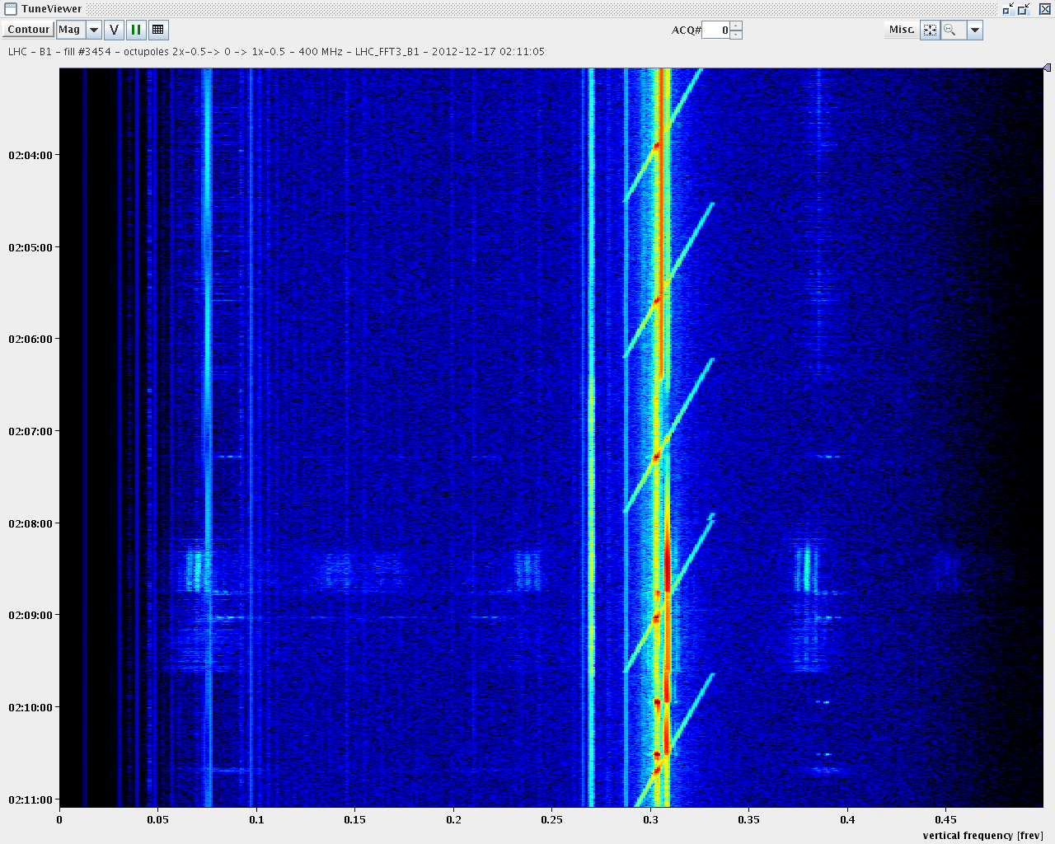
Analog Front-End – Frequency Domain V/V
ALTERNATE: Testing Stability Margin with HF Exciter (0.3-2.5 GHz)
nom. octupole setting
slow frev chirp@400 MHz
nom. octupole setting
reduced octupole setting
reduced octupole setting
Intra-bunch instability
nom. octupole setting
2012-12-16 B1-V

Slide 15
Digital Data Acquisition System & Post-Processing
Time-Domain I/III
Somewhat orthogonal requirements to be satisfied at the same time:
  track one bunch over few thousand turns to measure growth times
  track all bunches to detect/identify type of instability
  Huge buffers simplify triggering and data selection but also make smart memory management, online and automatic post-processing mandatory
Main idea: deploy a acquisition system similar to what is known in aviation as 'flight recorder'
  Record every turn & bunch for >10k turns and with bandwidth of 6 GHz
  Serves both 'post-mortem' (MP) and study buffer (ABP) requirements
turns up to 1s
32-64 GByte/ch
C)
A)
10 MByte/ch
B)
10 MByte/ch
fast axis (20 GS/s) 0 – 89 us

Slide 16
Digital Data Acquisition System & Post-Processing
Time-Domain II/III
A not on Gigabyte Sampling Buffers: The aim is not to systematically process, analyse and store the whole buffer but to allow data-mining in case of instabilities:
  Use-case example 1: Unstable bunches or batches are not known in advance. However, the guilty ones and timing can be identified with e.g. FastBCT and other instruments after the instability occurred → can be used to narrow the range of the data to be retrieved
  Use-case example 2: instrument could be used by several users with different diagnostics indicators at the same, e.g. 'user 1' monitors few bunches over maximum number of turns while 'user 2' acquires the first 500 full turns looking for bunch-by-bunch oscillations but at a reduced sampling frequency.
  Use-case example 3: keep specification open to allow future upgrades and R&D, i.e. present HT monitor was designed to measure Q' but not as instability monitor, larger buffer and bandwidth allowed the exploitation for other beam studies outside the scope during the design.

Slide 17
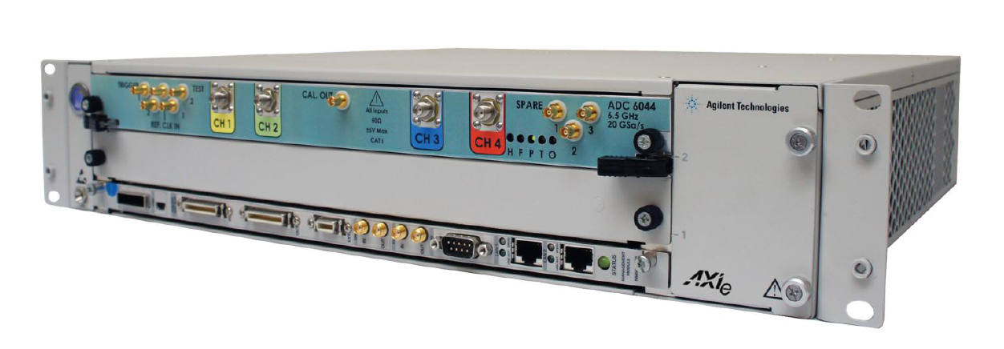
Digital Data Acquisition System & Post-Processing
Time-Domain III/III
Exploitation using scopes from Agilent, LeCroy and Agilent are time-proven but ultimately limited in available sampling memory, post-processing and reliability of controls integration
Interesting new candidate: Guzik's GSA & ADC 6000 Series
  4 (2, 1) channels @ 4 (6.5/8, 13) GHz
  16 (32) GB/ch sampling buffer ↔ monitoring of 1.6 s of beam data!
  Various on-line processing that could be exploited to pre-select data:
    FFT & DFT (per bunch, mag. Average, sub-frequency ranges), rise-time, bunch-width (FWHM), bunch statistics (average, r.m.s., min., max. signal), number of rising/falling edge → possible HT mode detection already in HW?
    Functionality to be explored → tested demo system for evaluation
System to deployed as part of the PS Ghost&Satellite detection and SPS intra-bunch (head-tail) upgrade as part of the LIU frame-work
No budget/confirmation for LHC

Slide 18
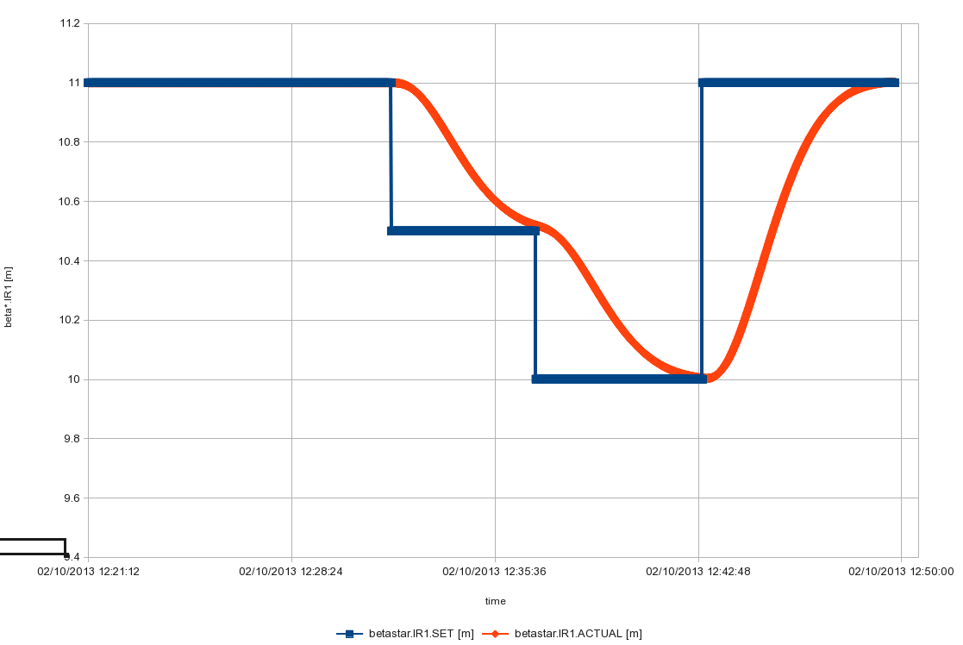
One-Slide on: Continuous Real-Time β* Squeeze
Beam Test going from β*(IP1) = 11.0 → 10.5→ 10.0 → 11.0 m
Aim of this exercise was to probe the feasibility of RT beta* leveling post-LS1
  mitigate pile-up with 50 ns beams (truly constant luminosity)
  mitigate beam instabilities issues using head-on beam-beam
Allows arbitrary changes (test on 2013-02-10, RS & ML):
N.B. naked squeeze in IR1 only with no prior orbit, Q/Q' corrections included. 2nd-order feed-down effects on tune and orbit clearly observed. Beam lifetime OK throughout test → to be further studied/explored for after LS-1
Implications on orbit, Q/Q' & L-control in particular IR BPM meas. quality
11 m
10.5 m
10.0 m
Requested β*
Actual β* (keeping PC dI/dt and dI2/dt2 limits

Slide 19
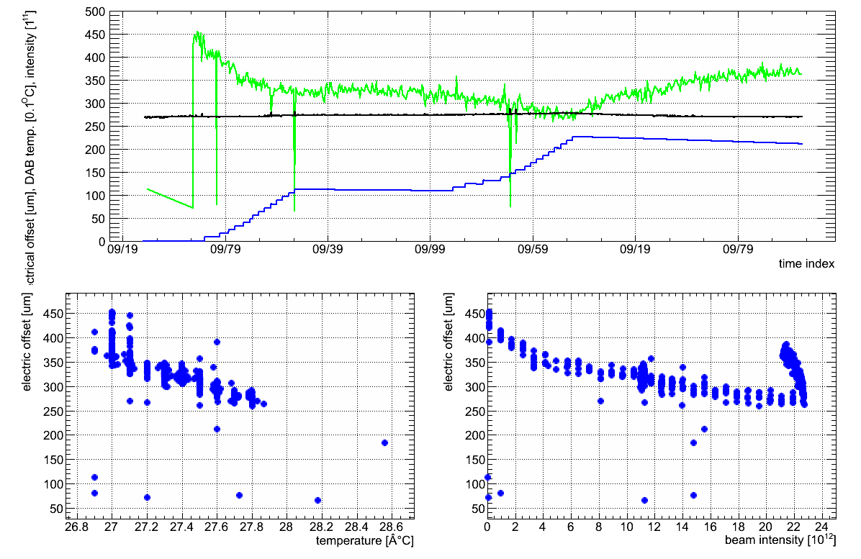
One slide on:
RF Commutation Switch and LHC BPM Electrical Offset Stability
no sig. T/nb change
~100 um
el. Offset BPMSW.1L5.B1-H
DAB Temperature
Beam Intensity
correlation with temperature
correlation with beam intensity
correlation with temperature

